Slide 1

Data Salon
Attention is all you need
Rong Yao
2019. 11.19

Slide 2

Prologue
Can I have your Attention please! The introduction of the Attention Mechanism in deep learning has improved the success of various models in recent years, and continues to be an omnipresent component in state-of-the-art models. Therefore, it is vital that we pay Attention to Attention and how it goes about achieving its effectiveness.

Slide 3
What is attention?
When we think about the English word “Attention”, we know that it means directing your focus at something and taking greater notice. The Attention mechanism in Deep Learning is based off this concept of directing your focus, and it pays greater attention to certain factors when processing the data.
In my presentation, Attention is one component of a network’s architecture, and is in charge of managing and quantifying the interdependence:
Between the input and output elements (General Attention)
Within the input elements (Self-Attention)

Slide 4

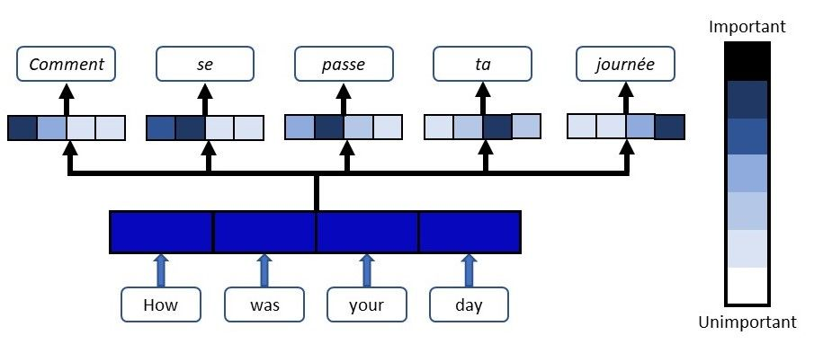
What is attention?
Human being
Network Architecture

Slide 5
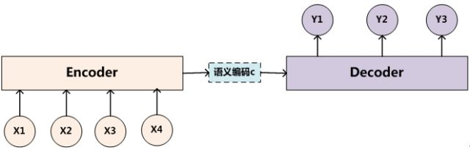

Encoder-Decoder Structure
Encoder-decoder in NLP
除了OCR、语音识别，自然语言处理有四大类常见的任务：
第一类任务：序列标注，譬如命名实体识别、语义标注、词性标注、分词等；
第二类任务：分类任务，譬如文本分类、情感分析等；
第三类任务：句对关系判断，譬如自然语言推理、问答QA、文本语义相似性等；
第四类任务：生成式任务，譬如机器翻译、文本摘要、写诗造句等。

Slide 6
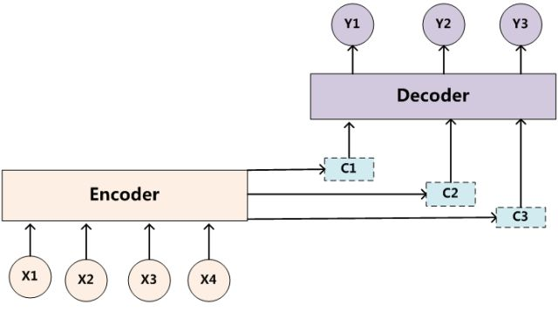


Attention
Tom chase Jerry
汤姆 追赶 杰瑞
Notes:
无论生成哪个单词，语义信息都是一样的，就像人类眼中没有注意焦点一样，比如翻译杰瑞，三个单词的比重都一样。

Slide 7

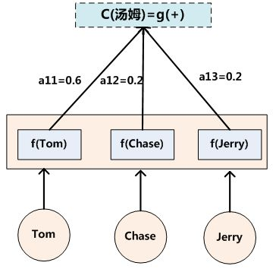
Attention
Tom chase Jerry
汤姆 追赶 杰瑞
How to get a_{ij}?
Notes:
A: attention score

Slide 8
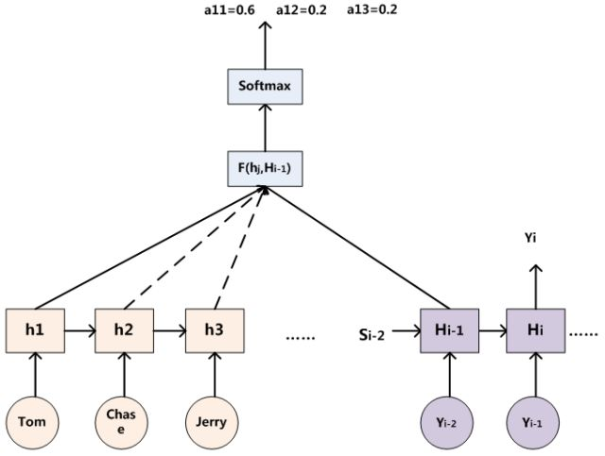
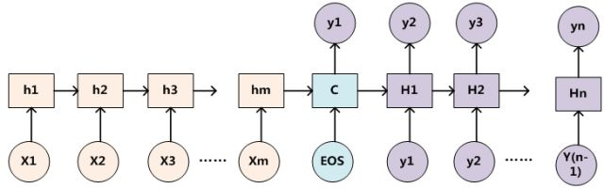


RNN as Encoder-Decoder Structure
$$a_{ij}=Softmax(F(h_{j},H_{i−1}))$$
or
$$a_{ij}=Softmax(F(h_{j},H_{i}))$$
tf.contrib.seq2seq.BahdanauAttention
Bahdanau D, Cho K, Bengio Y. Neural machine translation by jointly learning to align and translate[J]. arXiv preprint arXiv:1409.0473, 2014. (ICLR 2015)
tf.contrib.seq2seq.LuongAttention
Luong M T, Pham H, Manning C D. Effective approaches to attention-based neural machine translation[J]. arXiv preprint arXiv:1508.04025, 2015. (NMNLP 2015)

Slide 9
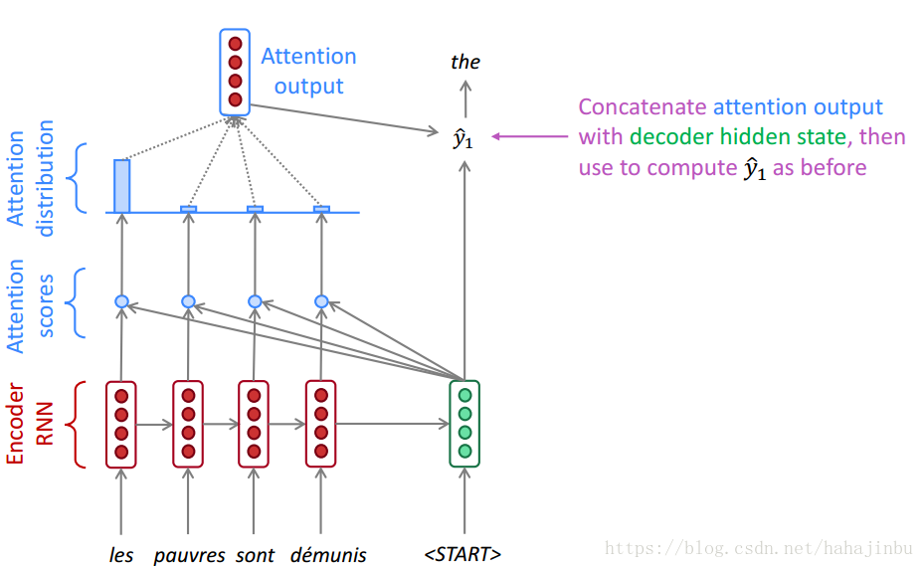
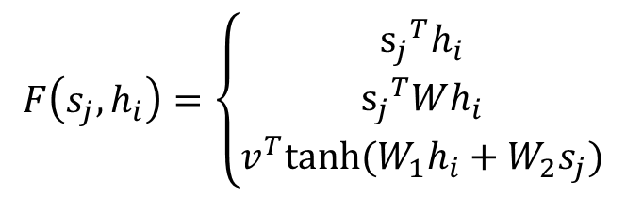


Attention Distribution (Soft attention)
$$a_{ij}=Softmax(F(s_{j},h_{i}))$$
$$c_{i}=\sum_{j=1}^{J}{a_{ij}h_{j}}$$
$$F\left(s_{j},h_{i}\right)=\left\{\begin{aligned}{s_{j}}^{T}h_{i} \\ {s_{j}}^{T}Wh_{i} \\ v^{T}tanh⁡({W_{1}h}_{i}+W_{2}s_{j})\end{aligned}\right.$$

Slide 10
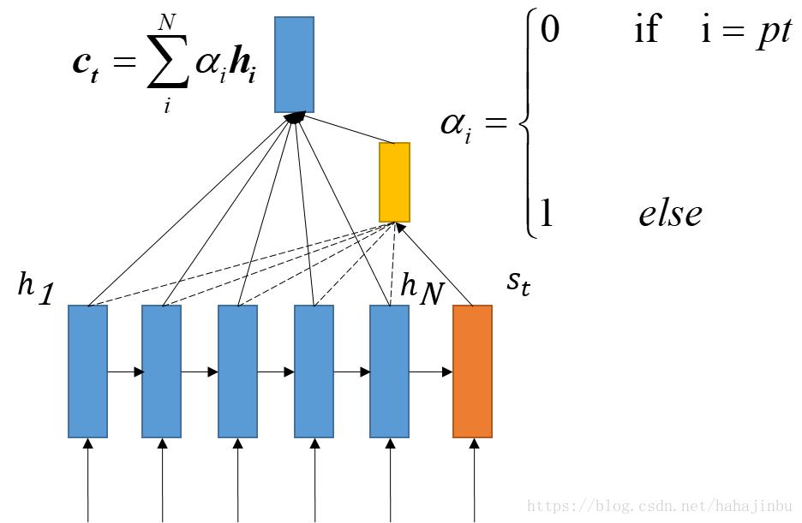
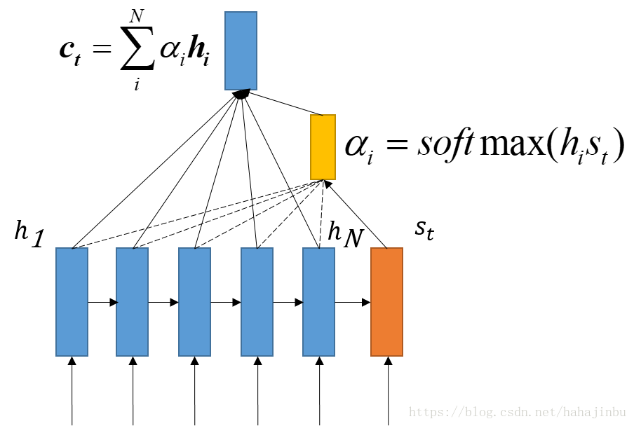
Hard Attention
Soft
Hard
(Select different areas in CV)
Consider all input words when calculate C (Global Attention).

Slide 11
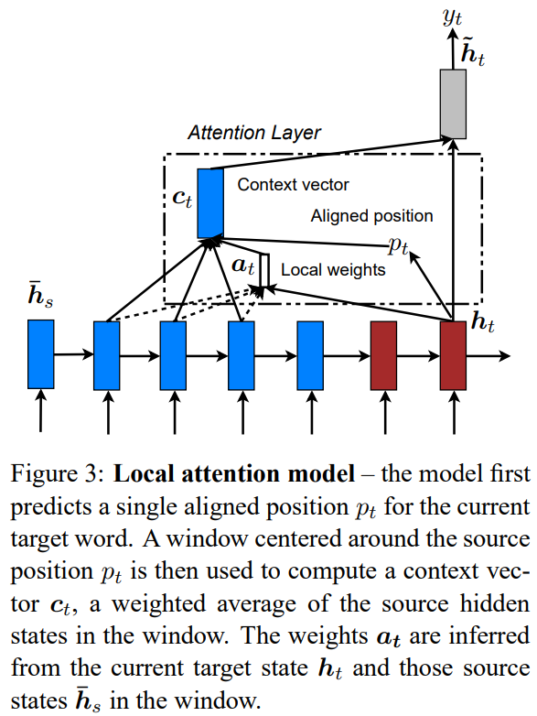
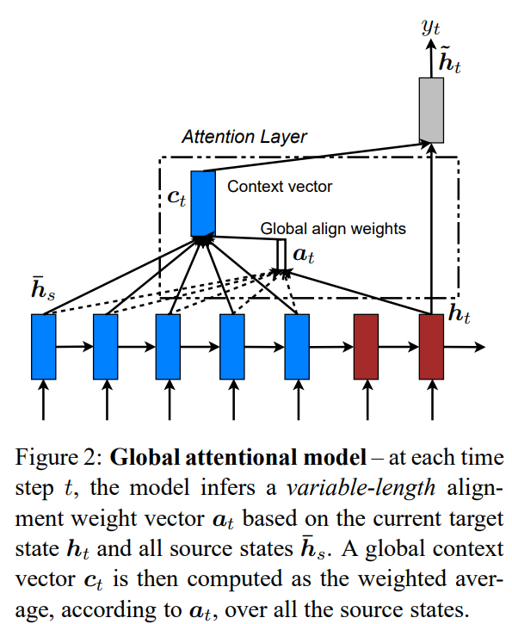
Local Attention
Luong M T, Pham H, Manning C D. Effective approaches to attention-based neural machine translation[J]. arXiv preprint arXiv:1508.04025, 2015. (NMNLP 2015)

Slide 12
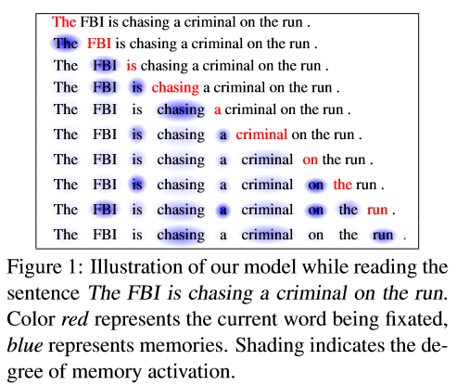
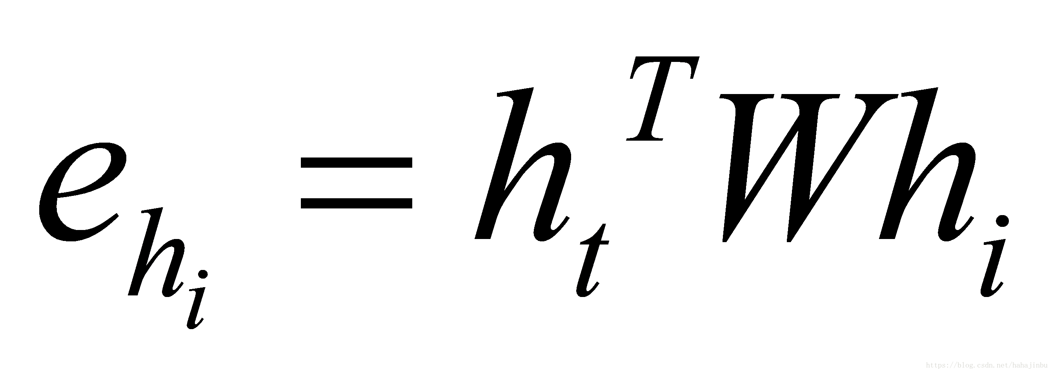
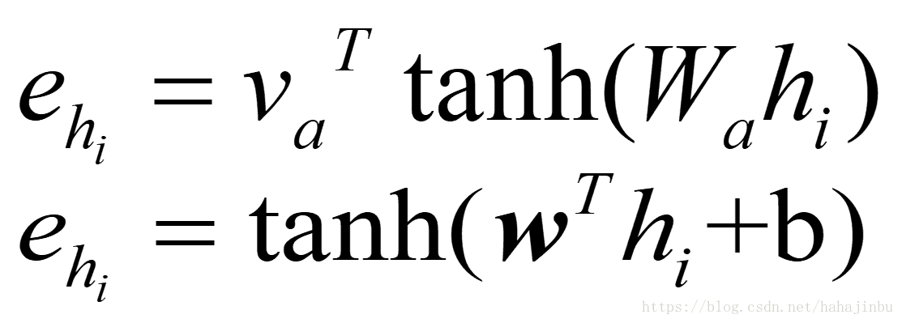
More special Attention: Self Attention (intra-attention)
Without extra information, we still can allow sentence use self attention mechanism process itself and get the important information from sentence. (no encoder-decoder)
use current hidden state and previous hidden state:
use current hidden only (simple and common):

Slide 13
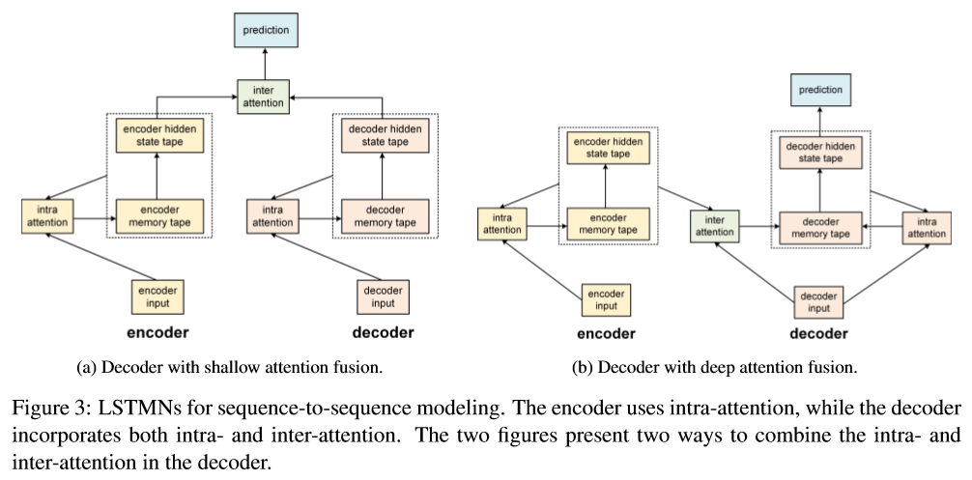
Inter attention & Intra attention
With the encoder-decoder network whose attention module learns the inter-alignment between two sequences. Figures 3a and 3b illustrate two types of combination. We describe the models more formally below.
Cheng J, Dong L, Lapata M. Long short-term memory-networks for machine reading[J]. arXiv preprint arXiv:1601.06733, 2016. (NMNLP 2016)

Slide 14
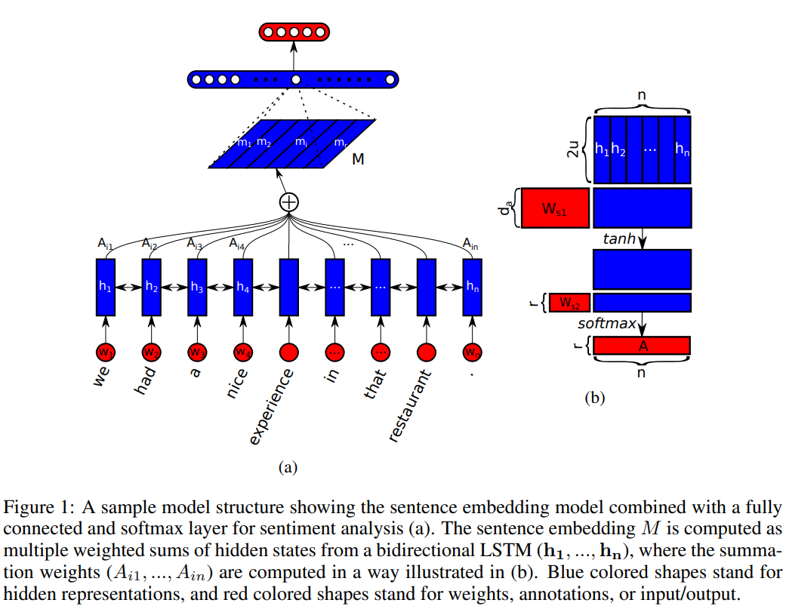

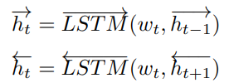


Self Attention used for sentence embedding
a sequence of word embeddings.
We use a bidirectional LSTM to process the sentence:
The attention matrix:
the resulting matrix is the sentence embedding
Lin Z, Feng M, Santos C N, et al. A structured self-attentive sentence embedding[J]. arXiv preprint arXiv:1703.03130, 2017. (ICLR 2017)

Slide 15
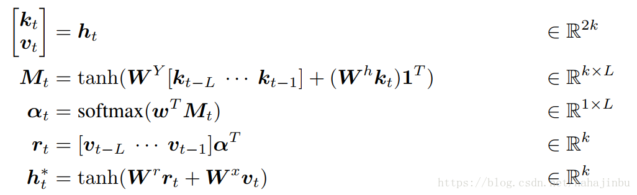
Query, Key and Value (Key-value attention)
When you type a query to search for some video on Youtube, the search engine will map your query against a set of keys (video title, description etc.) associated with candidate videos in the database, then present you the best matched videos (values).

Slide 16
Today’s topic
Attention is all you need!
Transformer
Multi-head attention
NIPS2017: Google

Slide 17
Introduction
Attention mechanisms have become an integral part of compelling sequence modeling and transduction models in various tasks, allowing modeling of dependencies without regard to their distance in the input or output sequences In all but a few cases , however, such attention mechanisms are used in conjunction with a recurrent network.
In this work we propose the Transformer, a model architecture eschewing recurrence and instead relying entirely on an attention mechanism to draw global dependencies between input and output.
The Transformer follows this overall architecture using stacked self-attention and point-wise, fully connected layers for both the encoder and decoder, shown in the left and right halves of figure in next page, respectively.

Slide 18
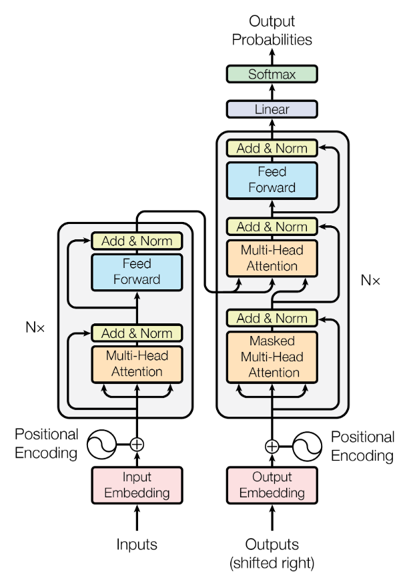
The Transformer-model architecture
Encoder: The encoder is composed of a stack of N = 6 identical layers. Each layer has two sub-layers. The first is a multi-head self-attention mechanism, and the second is a simple, position-wise fully connected feed-forward network. We employ a residual connection around each of the two sub-layers, followed by layer normalization. That is, the output of each sub-layer is LayerNorm(x + Sublayer(x)), where Sublayer(x) is the function implemented by the sub-layer itself. To facilitate these residual connections, all sub-layers in the model, as well as the embedding layers, produce outputs of dimension dmodel = 512.

Slide 19
The Transformer-model architecture
Decoder: The decoder is also composed of a stack of N = 6 identical layers. In addition to the two sub-layers in each encoder layer, the decoder inserts a third sub-layer, which performs multi-head attention over the output of the encoder stack. Similar to the encoder, we employ residual connections around each of the sub-layers, followed by layer normalization. We also modify the self-attention sub-layer in the decoder stack to prevent positions from attending to subsequent positions. This masking, combined with fact that the output embeddings are offset by one position, ensures that the predictions for position i can depend only on the known outputs at positions less than i.

Slide 20
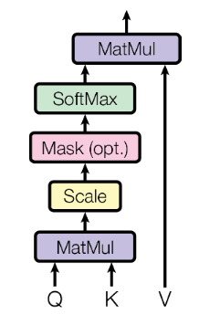

Scaled Dot-Product Attention
The input consists of queries and keys of dimension dk, and values of dimension dv:
Additive attention computes the compatibility function using a feed-forward network with a single hidden layer. While the two are similar in theoretical complexity, dot-product attention is much faster and more space-efficient in practice, since it can be implemented using highly optimized matrix multiplication code.
While for small values of dk the two mechanisms perform similarly, additive attention outperforms dot product attention without scaling for larger values of dk. We suspect that for large values of dk, the dot products grow large in magnitude, pushing the softmax function into regions where it has extremely small gradients. To counteract this effect, we scale the dot products by dk^(-0.5).
Notes:
原始 Attention = softmax(QK^T)V
令Q,K 为N(0,1)， 则q*k=sum(qi*ki) ~ N(0, dk)

Slide 21
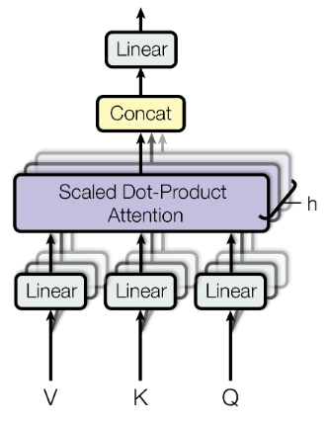


Multi-Head Attention
Instead of performing a single attention function with dmodel-dimensional keys, values and queries, we found it beneficial to linearly project the queries, keys and values h times with different, learned linear projections to dk, dk and dv dimensions, respectively. On each of these projected versions of queries, keys and values we then perform the attention function in parallel, yielding dv-dimensional output values. These are concatenated and once again projected, resulting in the final values

Slide 22
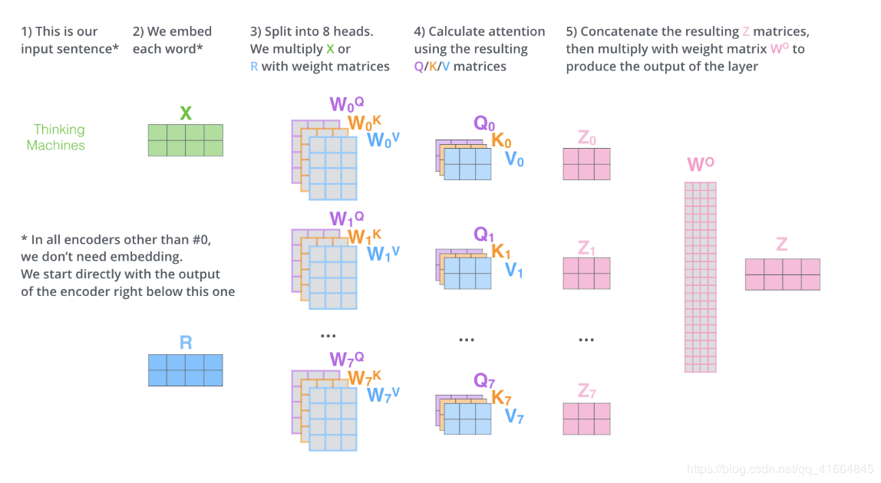
A Example of Multi-Head Attention
https://blog.csdn.net/qq_41664845/article/details/84969266

Slide 23
Multi-Head Attention in Transformer
"encoder-decoder attention" layers
In, the queries come from the previous decoder layer, and the memory keys and values come from the output of the encoder. This allows every position in the decoder to attend over all positions in the input sequence. This mimics the typical encoder-decoder attention mechanisms in sequence-to-sequence models.

Slide 24
Multi-Head Attention in Transformer
" The encoder self-attention" layers
The encoder contains self-attention layers. In a self-attention layer all of the keys, values and queries come from the same place, in this case, the output of the previous layer in the encoder. Each position in the encoder can attend to all positions in the previous layer of the encoder.

Slide 25
Multi-Head Attention in Transformer
" The decoder self-attention" layers
Similarly, self-attention layers in the decoder allow each position in the decoder to attend to all positions in the decoder up to and including that position. We need to prevent leftward information flow in the decoder to preserve the auto-regressive property. We implement this inside of scaled dot-product attention by masking out (setting to−∞) all values in the input of the softmax which correspond to illegal connections.

Slide 26

Position-wise Feed-Forward Networks
A fully connected feed-forward network, which is applied to each position separately and identically. This consists of two linear transformations with a ReLU activation in between.
dmodel-----dff------dmodel
512---------2048--------512
While the linear transformations are the same across different positions, they use different parameters from layer to layer.

Slide 27
Embedding and Softmax
Embedding: Share two Embedding layers
Softmax: Also shared with the pre-softmax linear transformation
In the embedding layers, we multiply those weights by dmodel^0.5

Slide 28

Position Encoding
How to make use of the order of the sequence?
CNN: convolution
RNN: recurrence
Transformer: position encoding (given directly)
positional encodings have the same dimension dmodel as the embeddings, so that the two can be summed. And for any fixed offset k, PEpos+k can be represented as a linear function of PEpos.
Shaw P, Uszkoreit J, Vaswani A. Self-attention with relative position representations[J]. arXiv preprint arXiv:1803.02155, 2018.
Notes:
Sin(a+b) = sinacosb+sinbcosa
cos(a+b)= cosacosb-sinasinb （p+k的位置可以由p的位置向量的线性变换，这提供了表达相对位置信息的可能性）

Slide 29
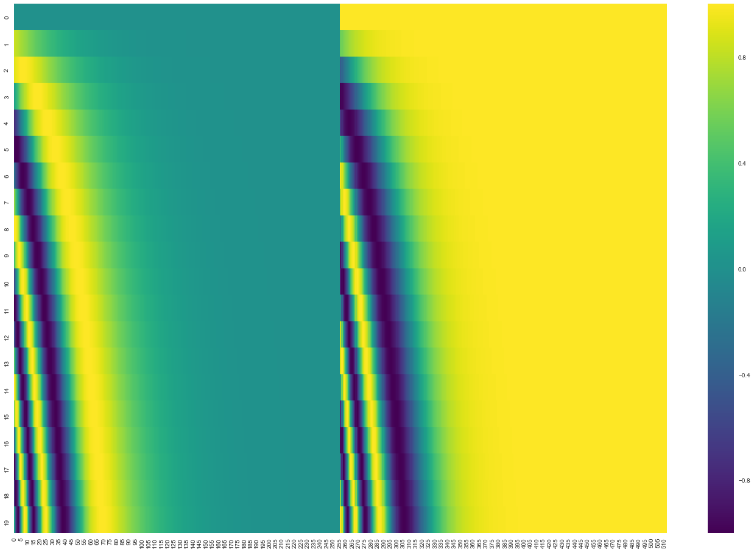
Position Encoding
Sum or concat?
The dimension order is the same!
Notes:
Concat，因为接权重矩阵，其实无妨
Sum，embedding后的向量其实没有局部结构

Slide 30
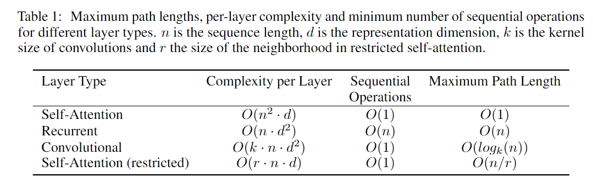
Why self-attention?
Simple and fast
As side benefit, self-attention could yield more interpretable models.
A gif example: https://blog.csdn.net/qq_41664845/article/details/84969266
Notes:
空洞卷积
Maximum path length: 长期依赖的最大长度

Slide 31
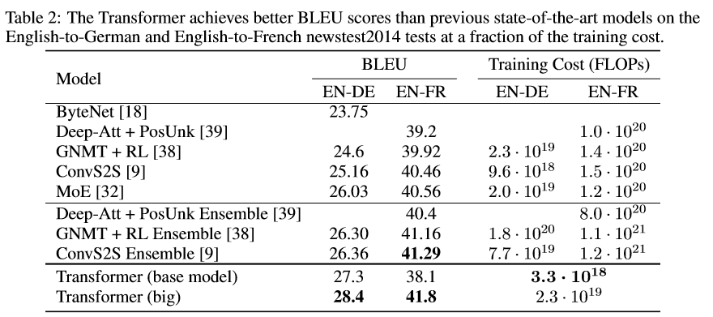
Experiments (Machine Translation)
WMT 2014 English-to-German translation task
WMT 2014 English-to-French translation task
State of art
More BLEU
Less cost

Slide 32
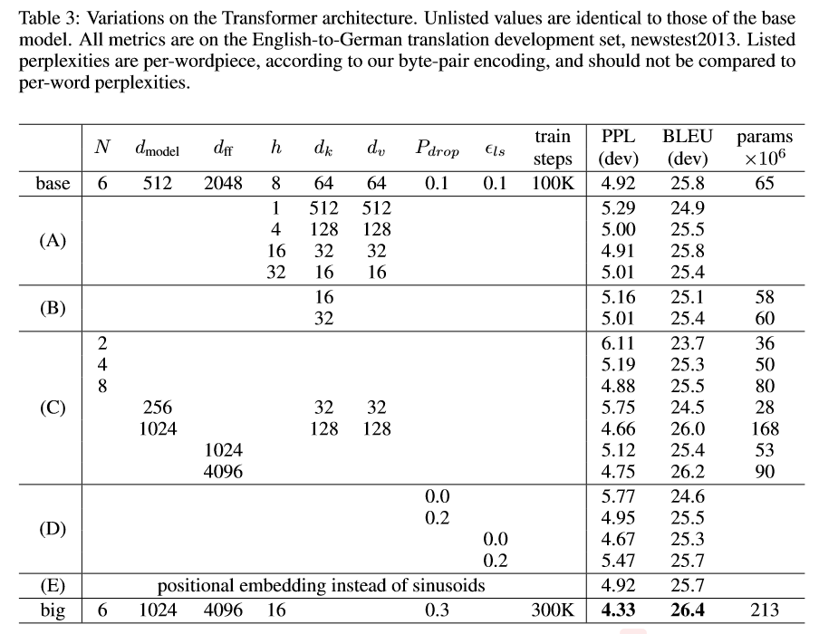
Experiments (Model Variations)
Qualities drop with too many heads
Reduce key size dk hurts model quality
(D) Bigger models are better
(E) Positional embeddings observe nearly identical results.

Slide 33
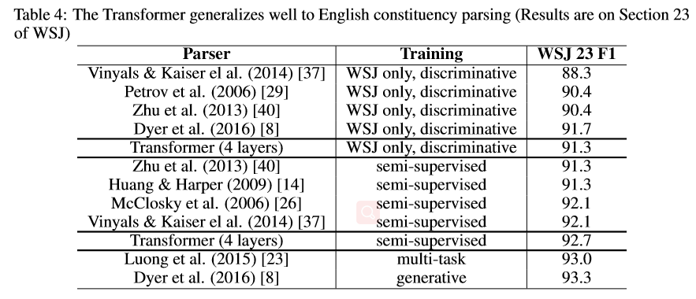
Experiments (English Constituency Parsing)

Slide 34
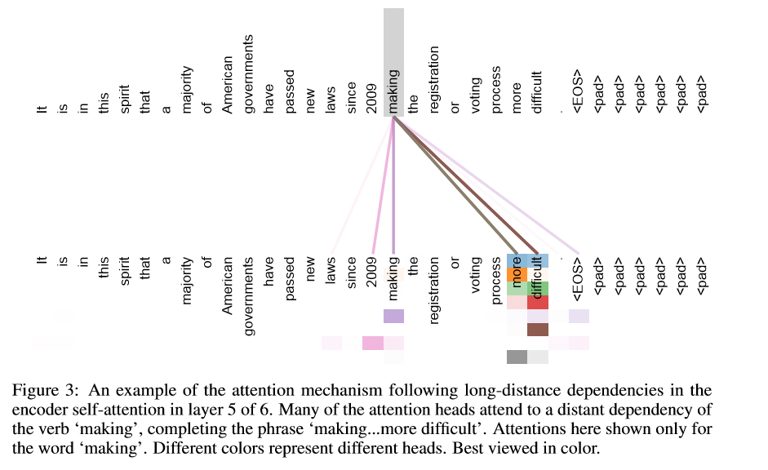
Attention Visualization

Slide 35
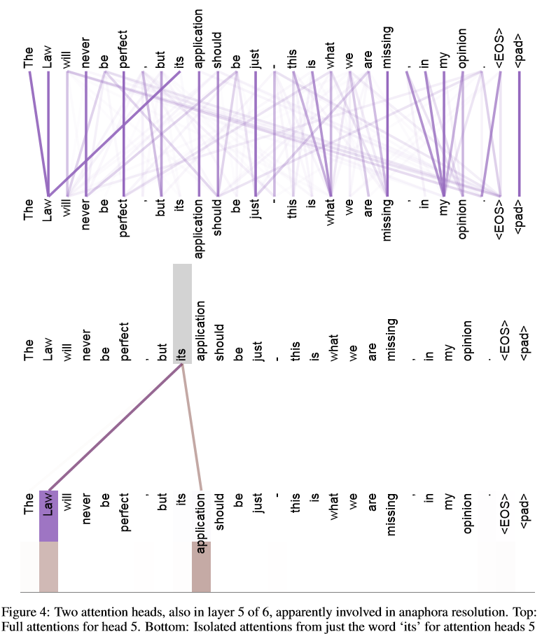
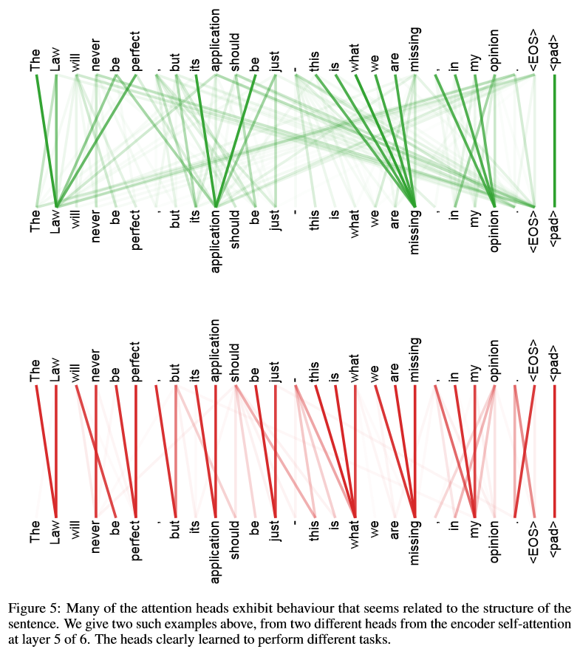
Attention Visualization

Slide 36
References
Vaswani A, Shazeer N, Parmar N, et al. Attention is all you need[C]//Advances in neural information processing systems. 2017: 5998-6008.
Bahdanau D, Cho K, Bengio Y. Neural machine translation by jointly learning to align and translate[J]. arXiv preprint arXiv:1409.0473, 2014. (ICLR 2015)
Luong M T, Pham H, Manning C D. Effective approaches to attention-based neural machine translation[J]. arXiv preprint arXiv:1508.04025, 2015. (NMNLP 2015)
Cheng J, Dong L, Lapata M. Long short-term memory-networks for machine reading[J]. arXiv preprint arXiv:1601.06733, 2016. (NMNLP 2016)
Lin Z, Feng M, Santos C N, et al. A structured self-attentive sentence embedding[J]. arXiv preprint arXiv:1703.03130, 2017. (ICLR 2017)
https://blog.csdn.net/qq_41664845/article/details/84969266

Slide 37
Conclusion
Attention起源于Encoder-Decoder，RNN等网络结构，实际上可能完全不受这个限制，只是一种思想
Attention层能一次捕捉全局的联系
Multi-head能学到不同的attention机制，表现得到很大提升
Transformer完全由 self-attention + tricks 支撑，摆脱了传统的CNN，RNN的结构，带来了惊人的表现和效率，和额外的可解释性
Transformer & BERT 在后续的各种数据集刷榜，证明了其优越性

Slide 38

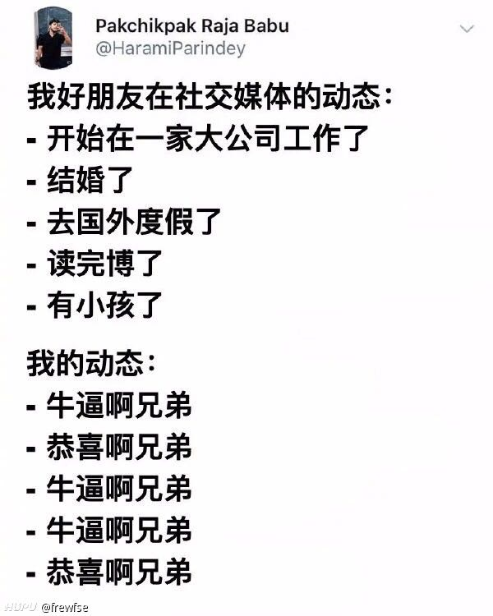


Surprise

Slide 39
Data Salon
THANK YOU!

